Slide 1
Urban Ministries of Durham
Jesus E. Vazquez
12-04-2019
Project 3 - BIOS 611

Slide 2

Background
Urban Ministries of Durham (UMD) is a homeless shelter that assists around 6,000 people each year who need food, shelter, clothing and/or supportive services.
Some of the programs that they offer include:
(1) Community shelter where people are given a place to sleep and assistance to help them find a home
(2) Community Café that serves three meals a day all year-round
(3) food and clothing closet for those that either need food or clothing.

Slide 3
Motivation
Validation of the organization efforts is needed to understand if UMD is doing a good job at helping people transform their lives which should be evaluated not only at the counselor level but at the administrative level as well.
Fraud Analysis: To inspect the work of the administration the tax records will be examined to show if there are any signs of fraudulent behavior.
New Disabilities: This project will examine if anyone gained a new disability while staying at the center. If any, we will identify what are the risk factors that can help identify and prevent these cases.

Slide 4
Methods
Data: Publicly available tax records and data provided by UMD were used in this study.
Fraud Analysis: Theoretically the first digit of the net income per year should follow the Benford's Distribution and any deviations suggest dishonest tax filing .These deviations will be tested by the Chi-Squared Test
New Disabilities: Bar plots will be used to illustrate the number of men and women who got a disability while staying UMD. A logistic regression will be used to identify risk factors that can help prevent future cases.

Slide 5
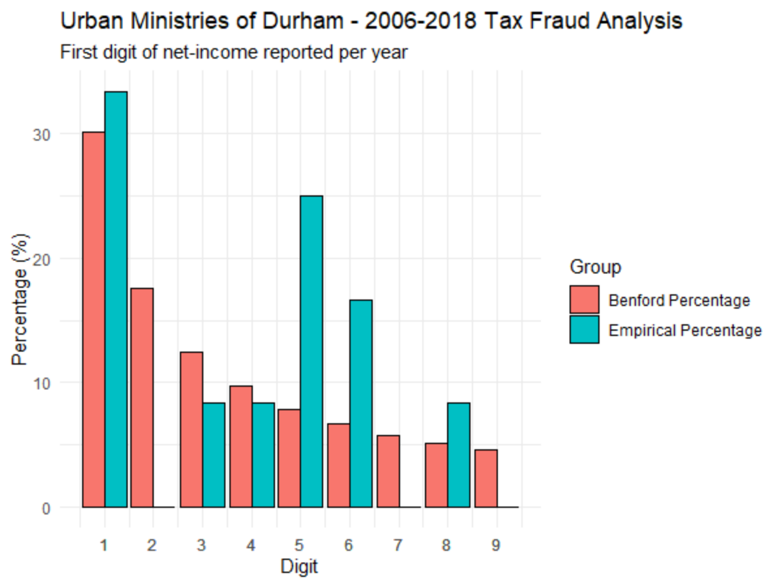
Not guilty of fraud
The Benford’s Distribution illustrates the expected distribution of the first digit of the net-income reported every year. The blue illustrates the distribution provided by UMD’s taxes.
 | Chi-Square | Wilcoxon
P-Value | 0.265 | 0.477
We conclude that neither test provides enough evidence that UMD engages in fraudulent tax-filing behavior.

Slide 6
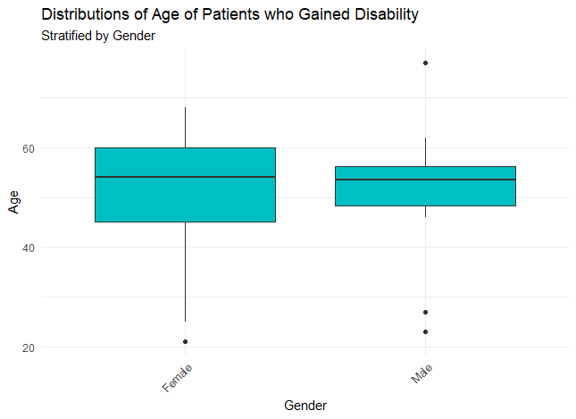
New Disabilities
Among the 38 cases of new disabilities:
- 18 Female and 20 Men
- Age distribution was roughly the same for men and women.

Slide 7
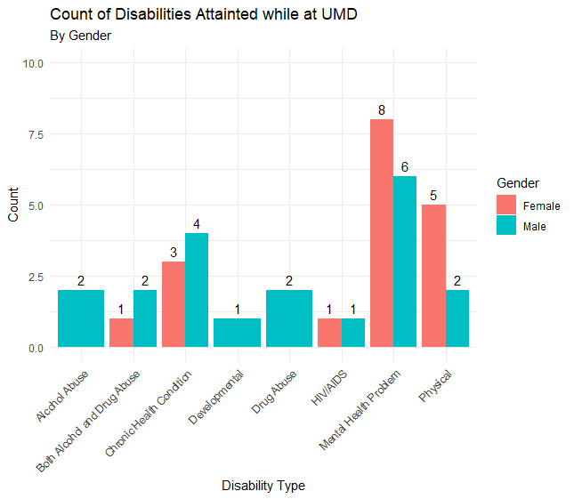
Women at a higher risk
Among the 38 cases of new disabilities:
- Men were included in every category
- Gain in Mental Health and Physical disabilities were greatly pronounced among women.

Slide 8
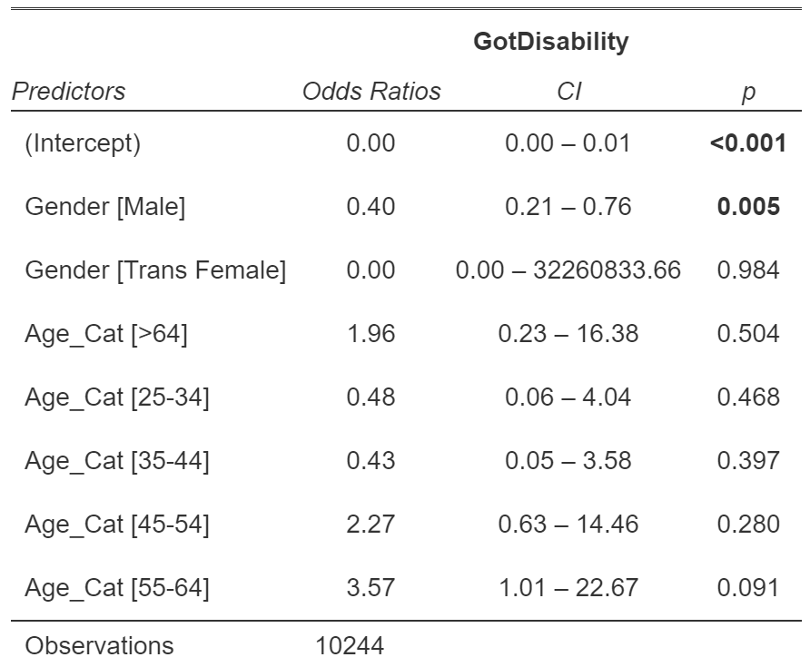
Identifying Risk Factors
A backward model selection was applied to the logistic regression model fitted to predict the instance of gaining a disability on all possible interactions between age, gender, and ethnicity.
Being a male resulted a protective factor in comparison to being a female.
Being in the 55-64 age category was a protective factor in comparison to the <25 age category.

Slide 9
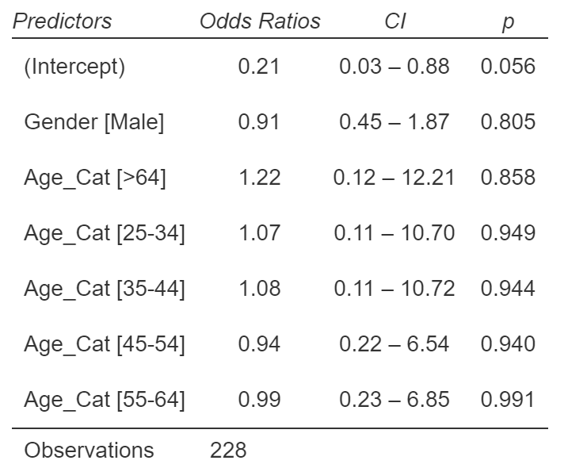
Adjusting for correct cohort
Case-Control: 1:5 Ratio
The case-control study results do not show signs of significance but from the output we can observe that being a male and older than 25 are now risk factors of getting a new disability while at staying at the UMD.
Although the case-control analysis did not have significant results, the estimates agree with the plots made in this project.

Slide 10
Conclusion
From this study we concluded that,
1. Urban Ministries of Durham did not commit fraud
2. There was a higher percentage of new disabilities developed at UMD to men overall, but women tended to attain new disabilities in the mental health and physical areas.
Urban Ministries of Durham should consider these findings when developing new programs to enhance the quality of living of members. Counselors should not only put extra attention with males in general for them not to develop additional disabilities, but also special attention to women in the area of mental health and physical problems.

